Slide 1
Portfolio Milestone Winter 2022
Syracuse University
MS Applied Data Science
Jiebin Zhu

Slide 2
Topics
About me
Overview
IST 618 – Information Policy
IST 652 – Scripting for Data Analysis
IST 664 – Natural Language Processing
IST 707 – Data Analytics
IST 718 – Big Data Analytics
MBC 638 – Data Analysis and Decision Making
Reflection

Slide 3

About me
Syracuse University
B.S. Finance ’20
B.S. Info. Management & Technology ’20
M.S. Applied Data Science ’22
Wayfair
Product Associate

Slide 4
Overview
Describe a broad overview of the major practice areas in data science.
Collect and organize data.
Identify patterns in data via visualization, statistical analysis, and data mining.
Develop alternative strategies based on the data.
Develop a plan of action to implement the business decisions derived from the analyses.
Demonstrate communication skills regarding data and its analysis for managers, IT professionals, programmers, statisticians, and other relevant professionals in their organization.
Synthesis the ethical dimensions of data science practice (e.g., privacy)

Slide 5

IST 618 – Information Policy
Learning Goal
Synthesis the ethical dimensions of data science practice (e.g., privacy)

Slide 6
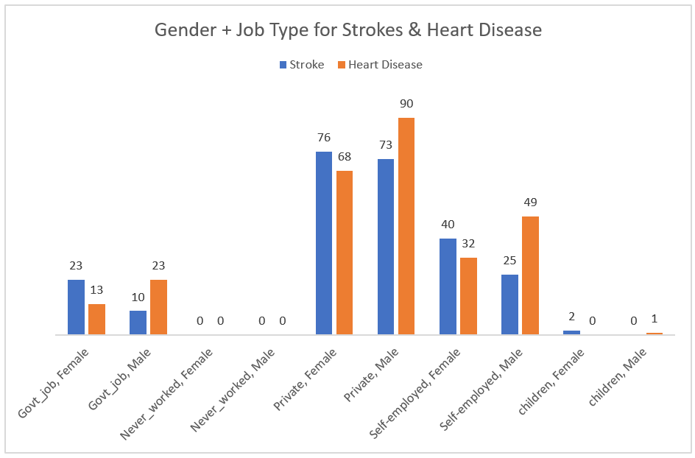
IST 652 – Scripting for Data Analysis
Learning Goals
Collect and organize data
Identify patterns in data via visualization, statistical analysis, and data mining.
Demonstrate communication skills regarding data and its analysis for managers, IT professionals, programmers, statisticians, and other relevant professionals in their organization.
Develop a plan of action to implement the business decisions derived from the analyses.

Slide 7
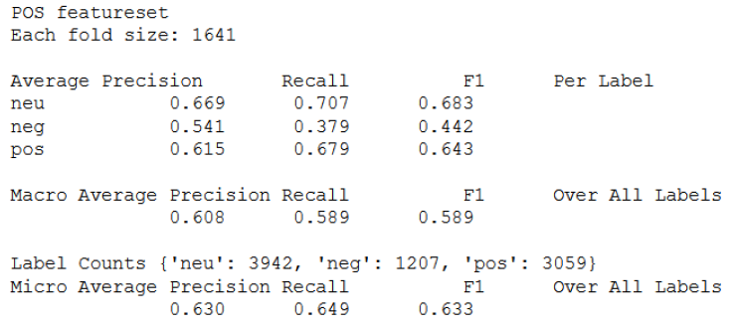

IST 664 – Natural Language Processing
Learning Goals
Demonstrate communication skills regarding data and its analysis for managers, IT professionals, programmers, statisticians, and other relevant professionals in their organization.

Slide 8
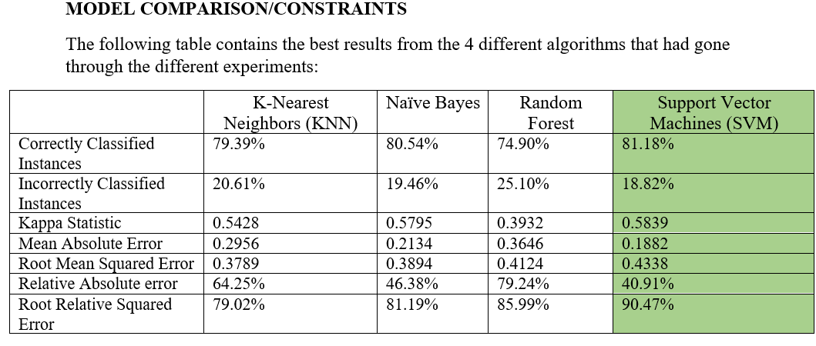
IST 707 – Data Analytics
Learning Goals
Describe a broad overview of the major practice areas in data science
Develop alternative strategies based on the data

Slide 9
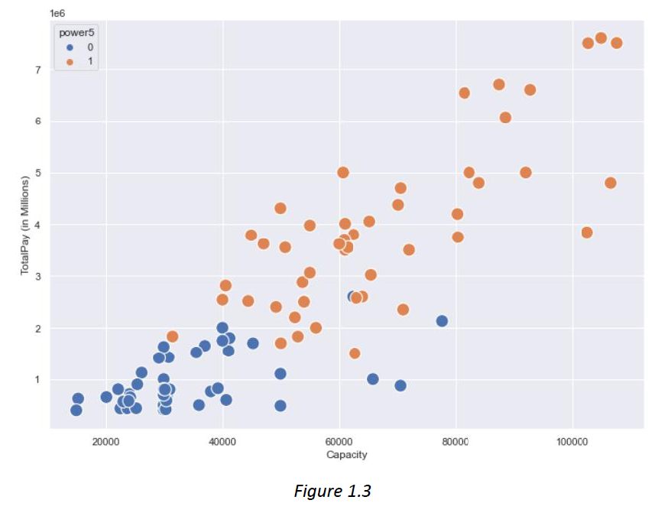
IST 718 – Big Data Analytics
Learning Goals
Collect and organize data
Develop alternative strategies based on the data.
Identify patterns in data via visualization, statistical analysis, and data mining.

Slide 10
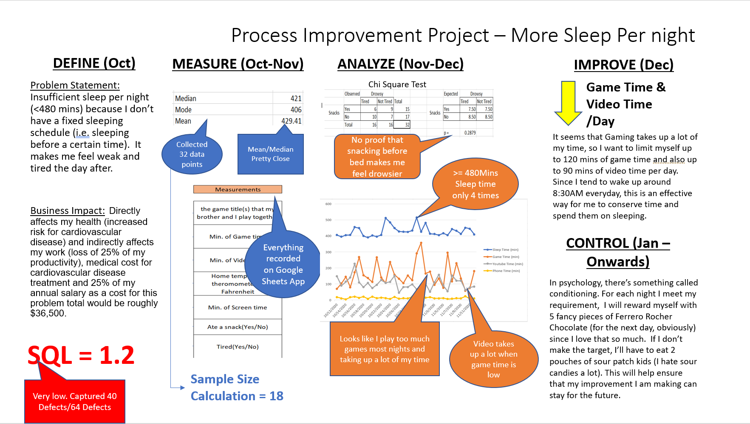
MBC 638 – Data Analysis and Decision Making
Learning Goals
Identify patterns in data via visualization, statistical analysis, and data mining
Develop a plan of action to implement the business decisions derived from the analyses

Slide 11

Reflection

Slide 12
Questions?
Email me at jzhu11@syr.edu

